Slide 1


H& M Customer Behavior Analysis

Slide 2

Uncovering Consumer Shopping Insights
Analyze customer shopping behavior using data from 1000 purchases
Understand subscription behavior
Identify spending patterns and customer segments
Analyze product preferences
Deliver actionable insights

Slide 3
Efficient Data Preparation Workflow: Applying structured cleaning steps using Python and pandas for reliable analysis
Contains 1,000 rows with 18 key columns spanning customer demographics, purchase details, and shopping behavior
Customer demographics include age, gender, location, and subscription status
Purchase details cover item, category, amount, season, size, and color
Shopping behavior tracked by discounts, promo code usage, purchase frequency, ratings, and shipping type
Missing data primarily in the discount column, with-483 values requiring imputation

Slide 4
Efficient Data Preparation Workflow
Data Loading
Inspect data structure
Missing Data Handling
Standardize column names

Slide 5

Streamlining Data: Feature Engine Streamlining Data
- Created age_group and purchase_frequency_days to enrich data.
- Removed promo_code_used due to redundancy with discount_applied.
- Integrated cleaned data into MySQL for SQL-based analysis.

Slide 6

Unlocking Insights with SQL Analysis
Males spend slightly more than females.
Subscribers generate twice the revenue.
Top 5 items lead in sales.
Ages 26–35 spend the most.
Focus on key segments and bestsellers for growth.

Slide 7
SQL Insights Driving Customer Value: Uncovering key revenue drivers, regional patterns, and purchase behaviors
Top promo code identified by highest revenue contribution
Regional insights
Shipping type comparisons
Top-rated items
Impact of purchase frequency

Slide 8

Power BI Dashboard Drives Informed Decisions
Visualize customer segments by gender, age, and location for targeted insights
Compare revenue from subscribers vs. non-subscribers to evaluate growth channels
Highlight top-performing products and promo codes to optimize marketing efforts
Analyze relationships between review ratings, purchase frequency, and spending for customer behavior insights
Supports real-time business monitoring and decision-making for agile strategy adjustments

Slide 9
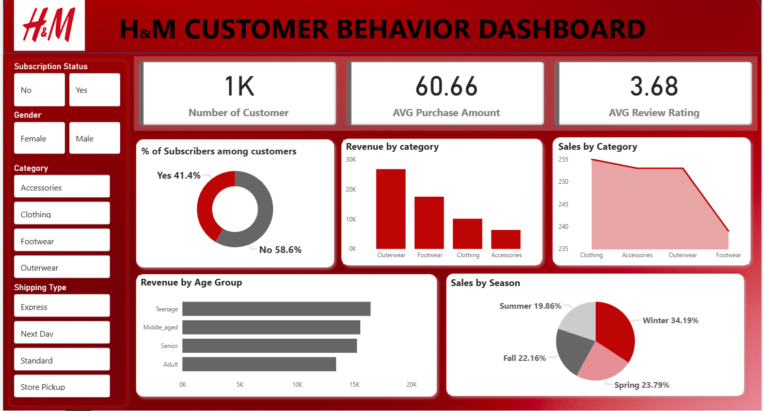

Slide 10

Drive Growth with Targeted Business Strategies
Boost subscriptions by promoting exclusive member benefits
Reward repeat buyers with loyalty program to increase retention
Review and optimize discount policies to balance sales volume and profit margins
Highlight top-rated and best-selling products in all marketing campaigns
Target high-revenue age groups and express shipping customers with focused campaigns

